Slide 1
Practical - 2
Explore and Perform Project Management using the tool you have selected in Practical 1.
20BCM015

Slide 2
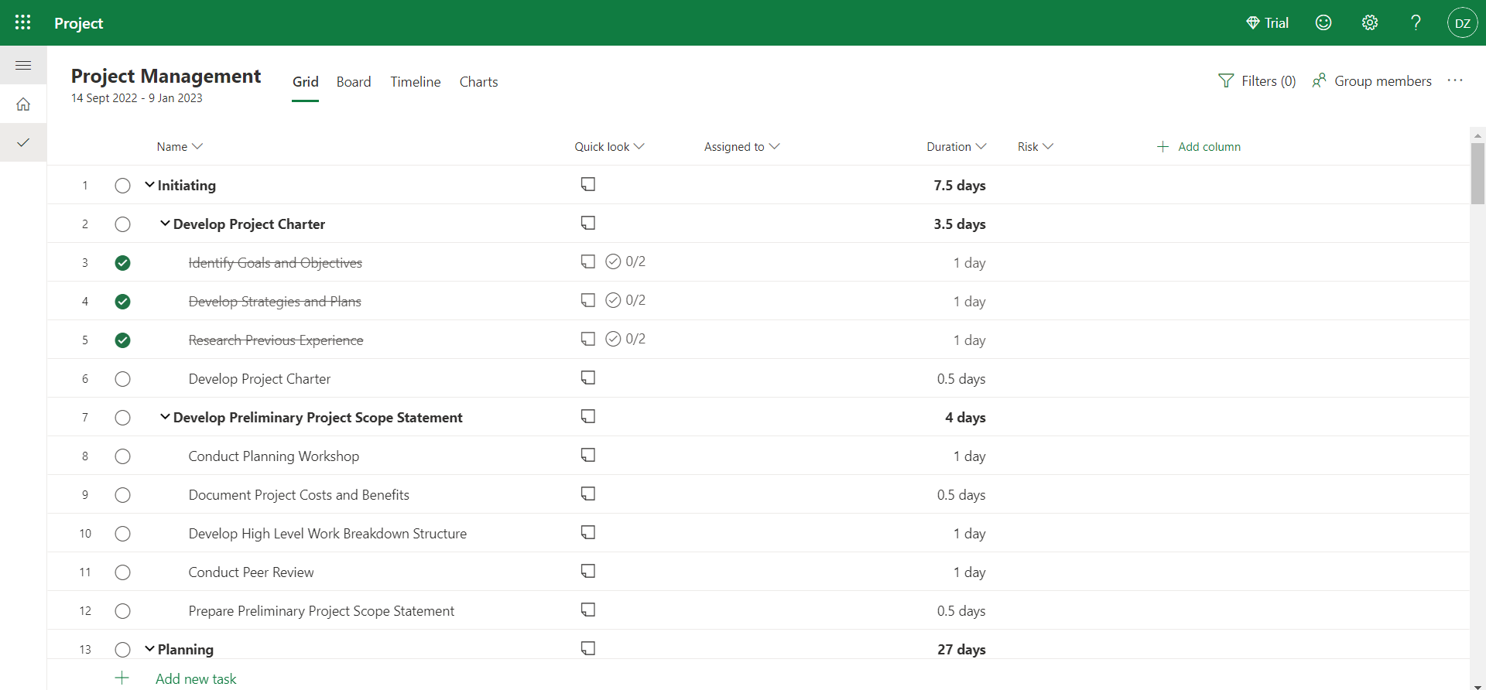

Slide 3
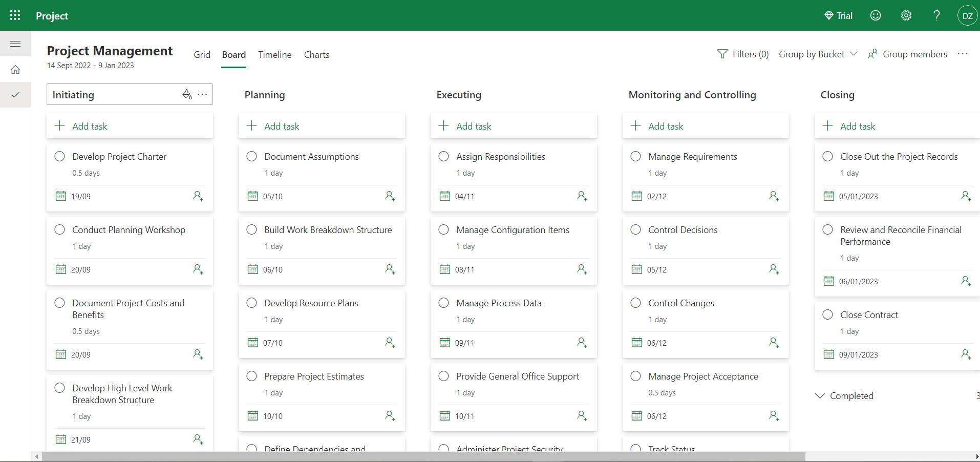

Slide 4
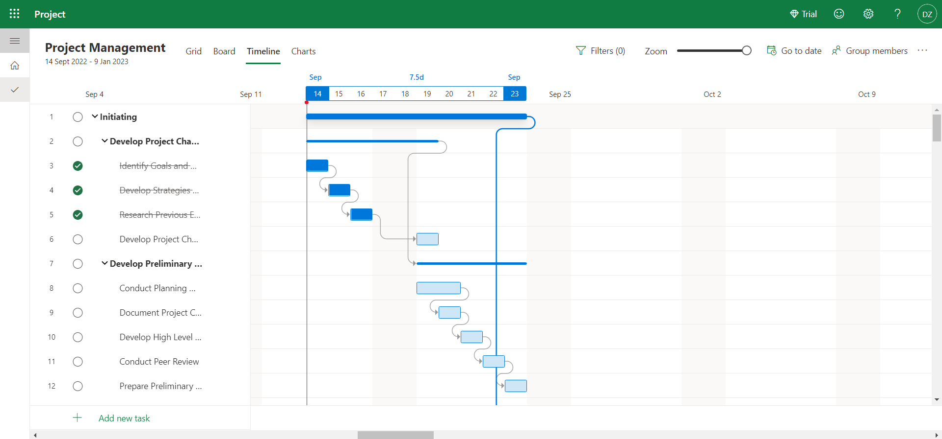

Slide 5
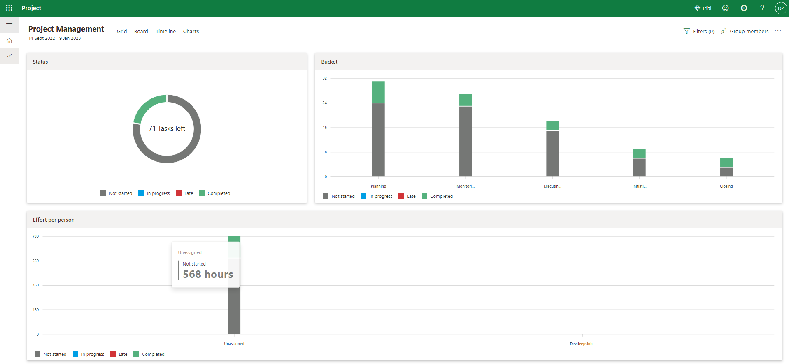

Slide 6
References
-> All these screenshot are taken from web version (under free trial) of Microsoft Project.
-> One can get free trial version for Microsoft Project by creating a business account under Microsoft which does not requires providing card details.
-> Website:
https://www.microsoft.com/en-in/microsoft-365/project/project-management-software

Slide 7
THANK YOU

